Slide 1
Defining Forest Health in Managed Forests
2016 VMC Annual Conference
Sandy Wilmot
Vermont Forests, Parks & Recreation

Slide 2
Vermont Division of Forests
Mission Statement
We protect and manage
for healthy forests.
Notes:
I love Vermont. I love Vermont forests and want to be able to hold onto what I believe is the best feature of our state: awesome forests. I am not here to criticize any group, practice, or philosophy, but rather I want to frame healthy forests in a way that allows us to assess status and trends, and identify when there are problems that can be addressed through management. Knowledge can bring action. Above all, I welcome your ideas.

Slide 3
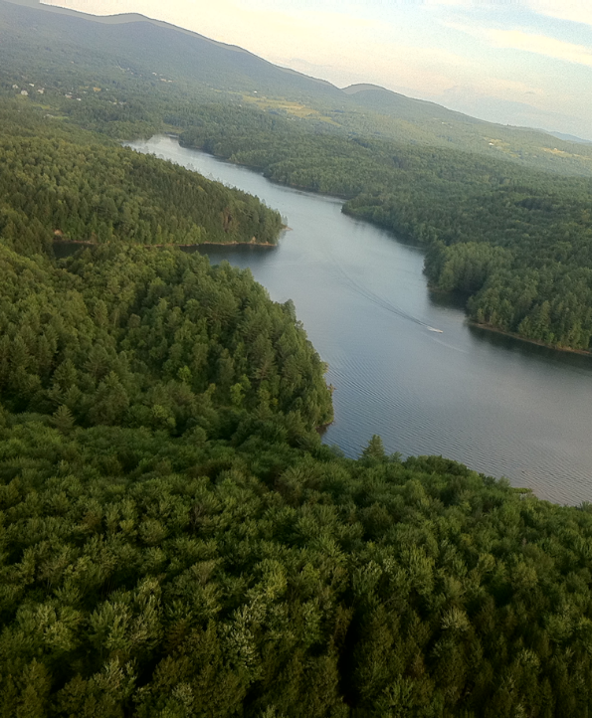
Are our forests healthy?
Notes:
At a forest stand level, I think natural resource professionals can take measurements and evaluate forest health and develop forest management plans that strive towards healthy forests.
From a broader perspective, how do we know 1. if forests are unhealthy, 2. if forests are in a transitional stage to become healthy, 3. if forests will never self-renew, 4. what time frame should be used for our self-renewal definition?.

Slide 4
Science. 2015 Aug 21;349(6250):814-8. doi: 10.1126/science.aac6759.
Forest health and global change.
Trumbore S¹, Brando P², Hartmann H³. https://www.ncbi.nlm.nih.gov/pubmed/26293952
National Institute of Health Website
It is particularly critical to identify thresholds for rapid forest decline, because it can take many decades for forests to restore the services that they provide.
Although native forests are adapted to some level of disturbance, all forests now face novel stresses in the form of climate change, air pollution, and invasive pests. Detecting how intensification of these stresses will affect the trajectory of forests is a major challenge.

Slide 5
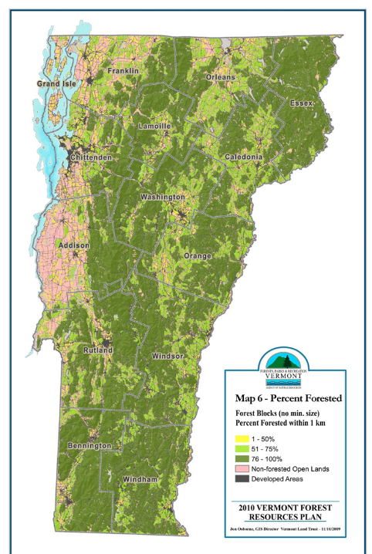
Vermont forests cover 75% of land area
Forest Health = Forest Abundance
Notes:
Forests are biological communities dominated by trees and including other organisms, their physical environment and interactions.

Slide 6
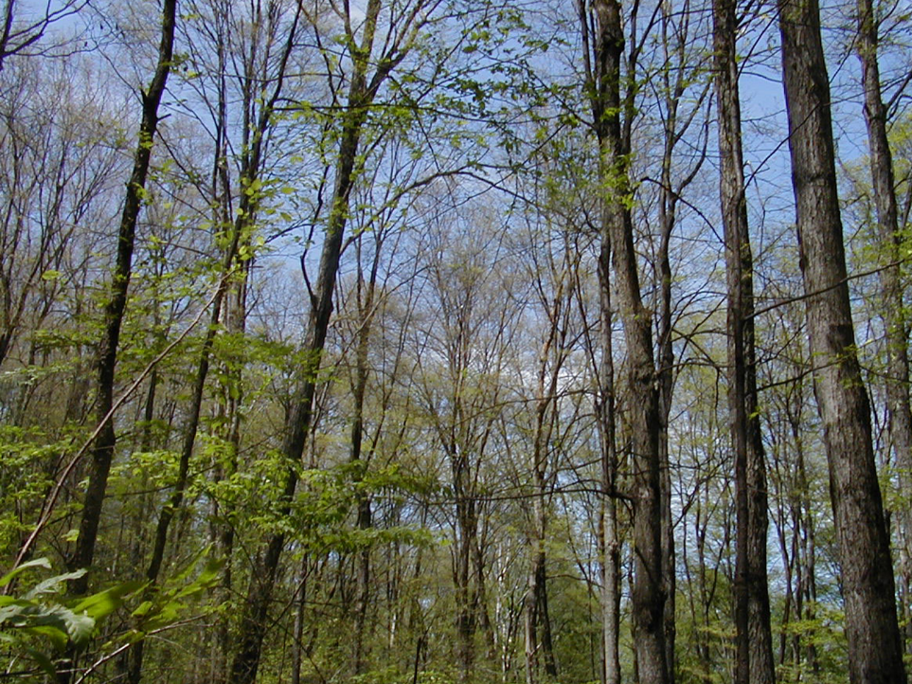
Forest Health =
A condition where biotic and abiotic influences do not threaten management objectives now and in the future.

Slide 7
Vermont Forest Monitoring Summary for 2016
Monitoring biotic and abiotic stressors

Slide 8
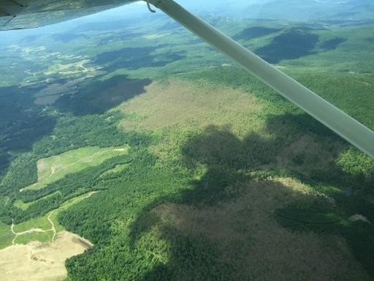
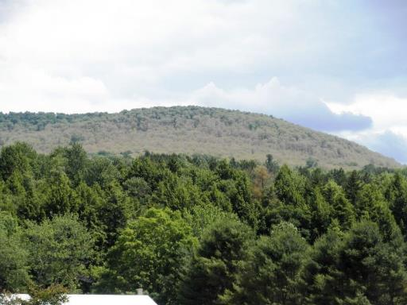
Forest Tent Caterpillar Defoliation

Slide 9
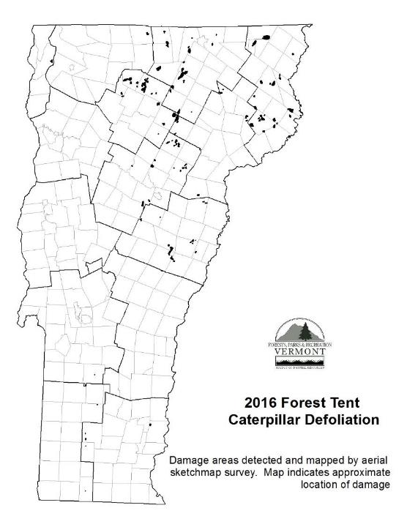
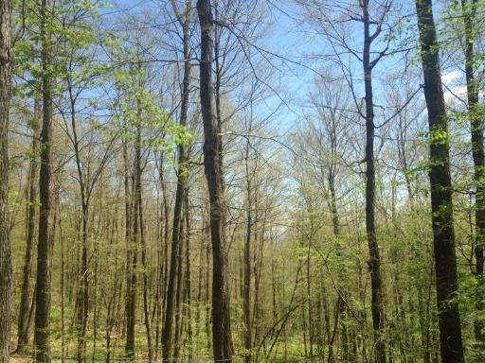

Slide 10
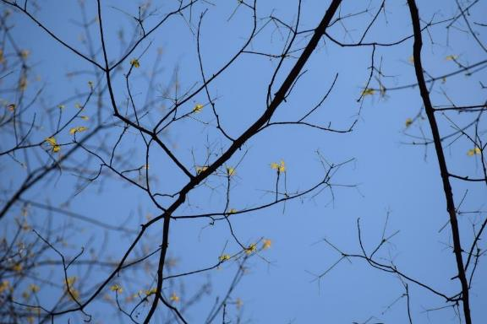
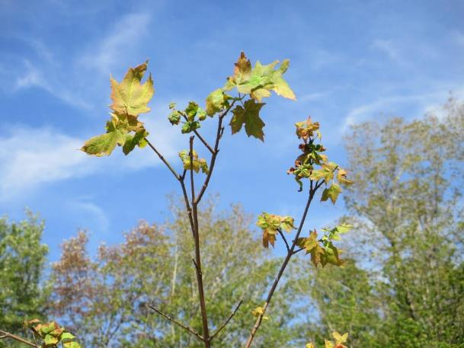
Refoliation

Slide 11
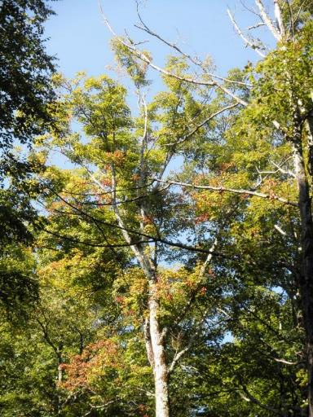
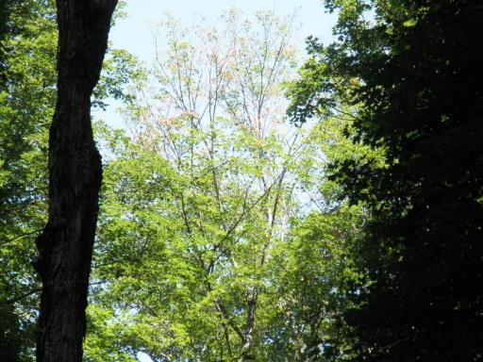
Drought Symptoms

Slide 12
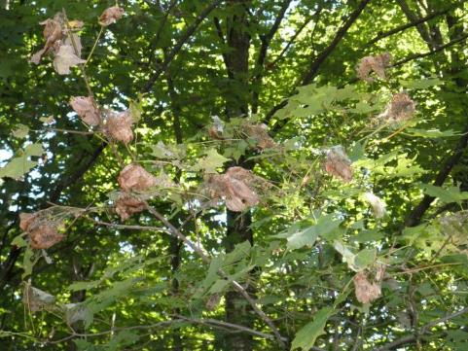
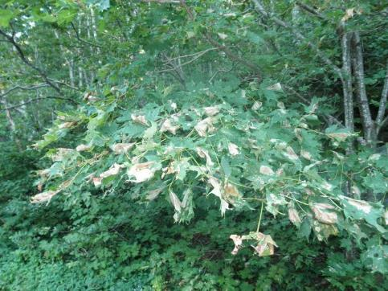
Maple Webworm
Pococera asperatella
formerly Tetralopha asperatella
Maple Trumpet Skeletonizer
Notes:
In 1980:
Associated with leaves rolled by Sparganothis pettitana as well as those folded by the maple trumpet skeletonizer, Epinotia aceriella
2004 Webworm Observations:
Commonly observed causing heavy damage to remaining leaves in stands already defoliated by forest tent caterpillar. Particularly common in leaves occupied by tent caterpillar pupae.

Slide 13
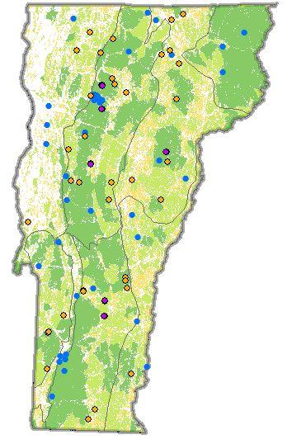
Sugar Maple &
VMC Forest Health Monitoring Plots

Slide 14
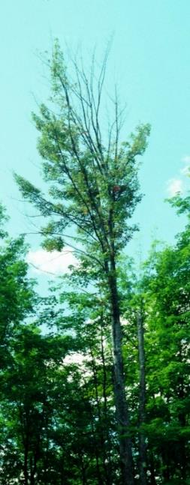
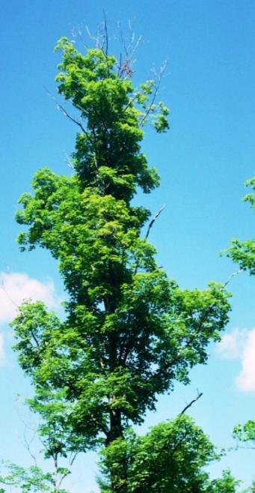
55% Dieback
15% Transparency

Slide 15
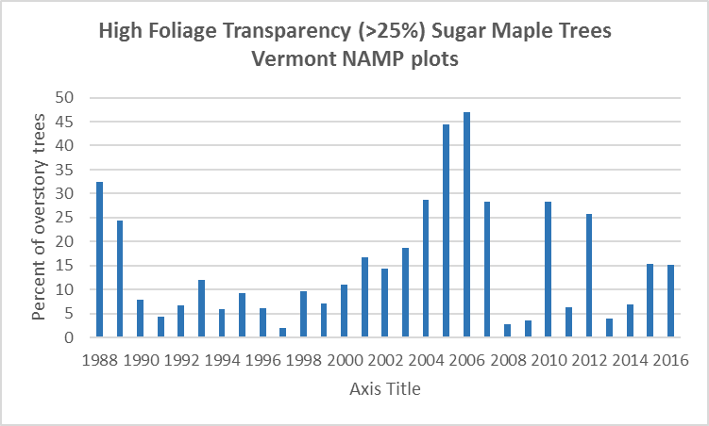
Forest tent caterpillar
Pear thrips
Frost

Slide 16
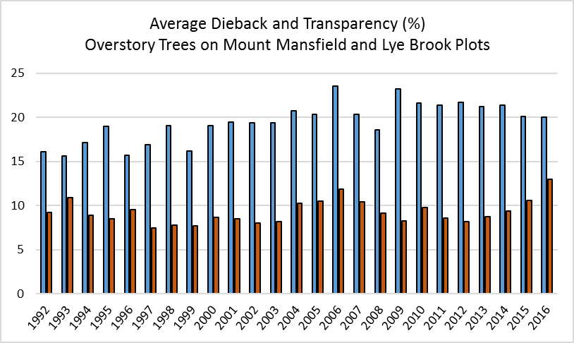
Tree health on VMC plots

Slide 17
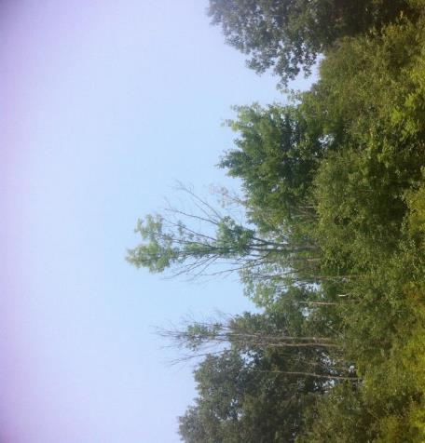
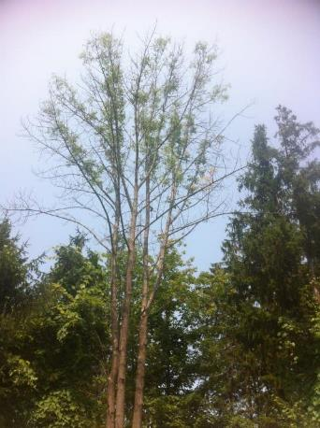
Ash Declines

Slide 18
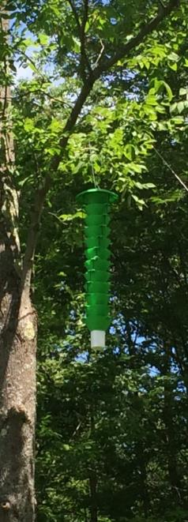
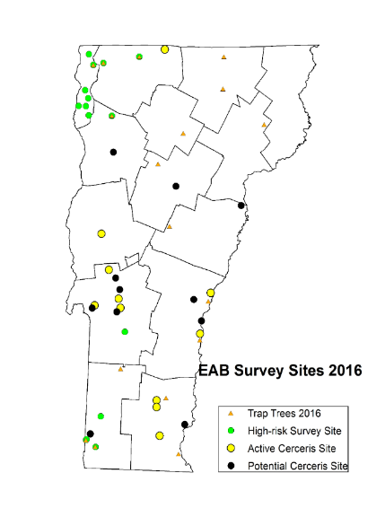
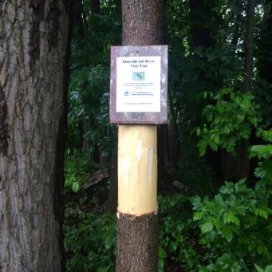
Ash Surveys
2016 Northwestern Sites
10 sites
1 purple & 1 green trap/site
6 sites with girdled trap trees

Slide 19
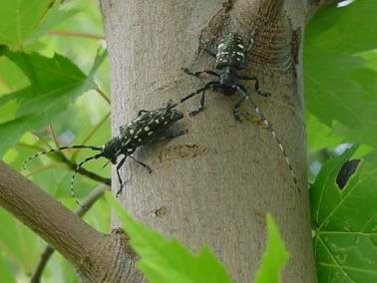
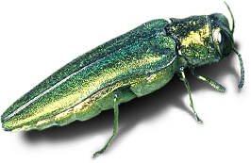
Not Known to Occur in Vermont
Emerald Ash Borer
Asian long horned beetle

Slide 20
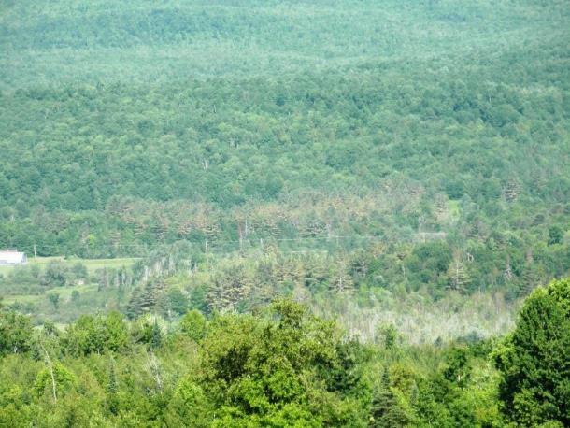
White Pine Needle Damage

Slide 21
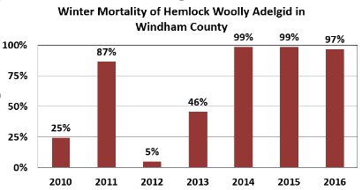
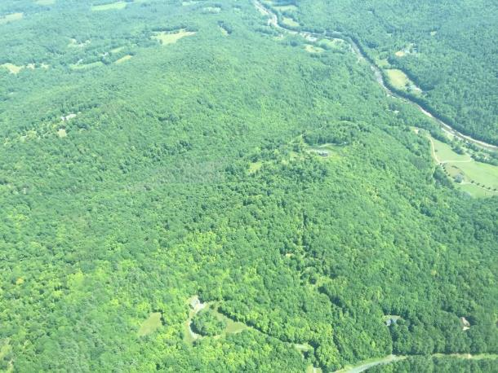
Hemlock Woolly Adelgid

Slide 22
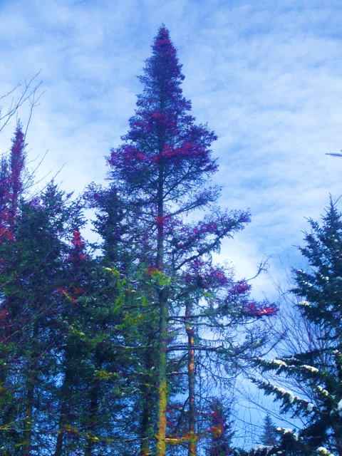
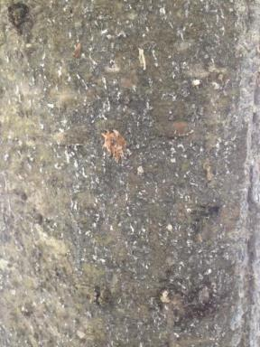
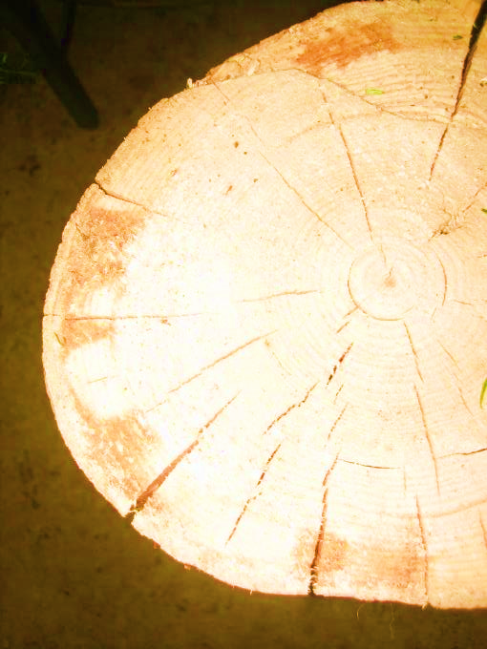
Balsam Woolly Adelgid Northeastern VT

Slide 23
Are our forests healthy?

Slide 24
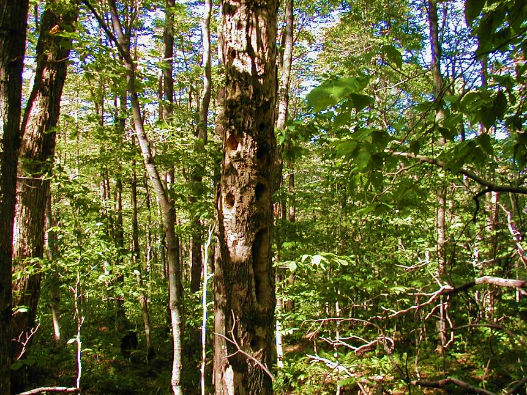
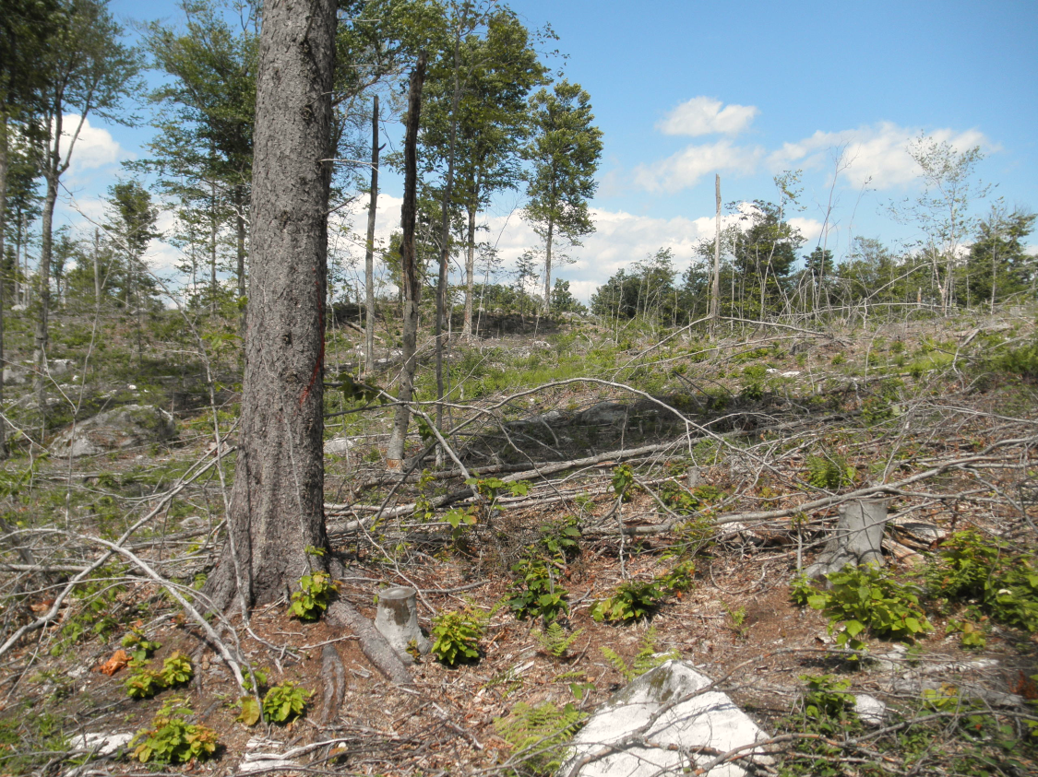
Notes:
An abundance of dead snag trees could be part of a landowners desired condition to provide increase animal habitat. A patch cut without abundant regeneration could be part of a landowner’s objectives to restore a stand. So if we consider forest health as a desired condition, a noun, it may be difficult to evaluate. But if we consider forest health as a dynamic continuum that we can influence in a positive way, then this verb forest health is an active work in progress.

Slide 25
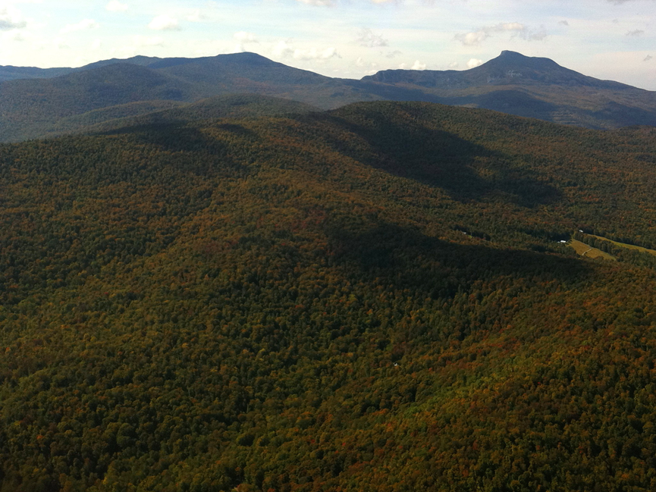
Defining forest health integrates utilitarian and ecosystem measures of forest condition and function, implemented across a range of spatial scales.
Notes:
Uses determined by the landowner or land manager are coupled with ecological parameters. This was made clear to me during several recent surveys we did where landowner objectives were unknown. So when you take metrics about the condition of the forest, you can’t evaluate the information.

Slide 26
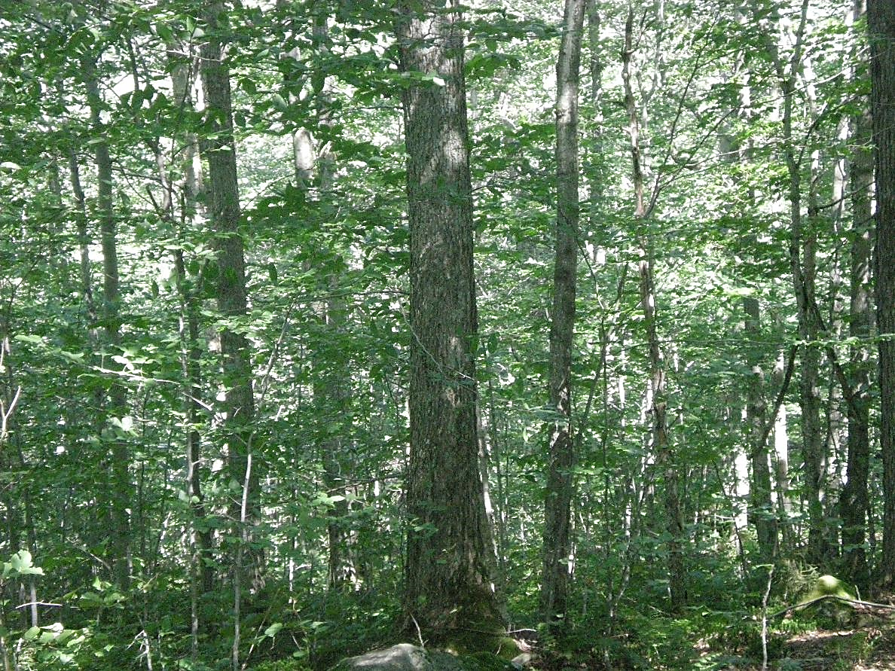
What are our expectations for healthy forests?
Notes:
Rural forests under silviculture we have metrics.

Slide 27
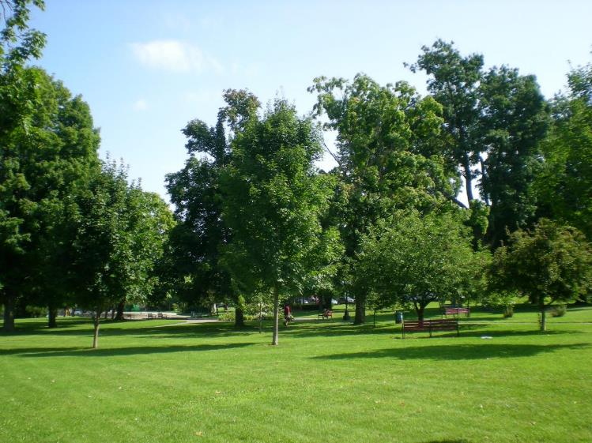
What are our expectations for healthy forests?
Notes:
Street trees or parks

Slide 28
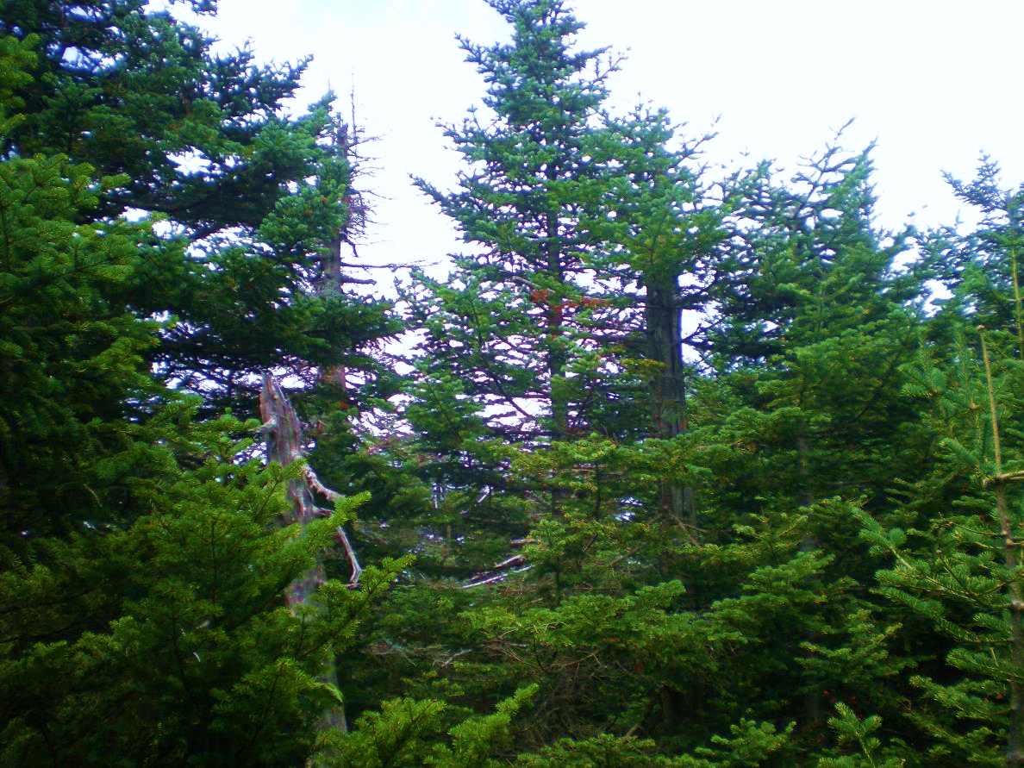
What are our expectations for healthy forests?
Notes:
High elevation forest

Slide 29
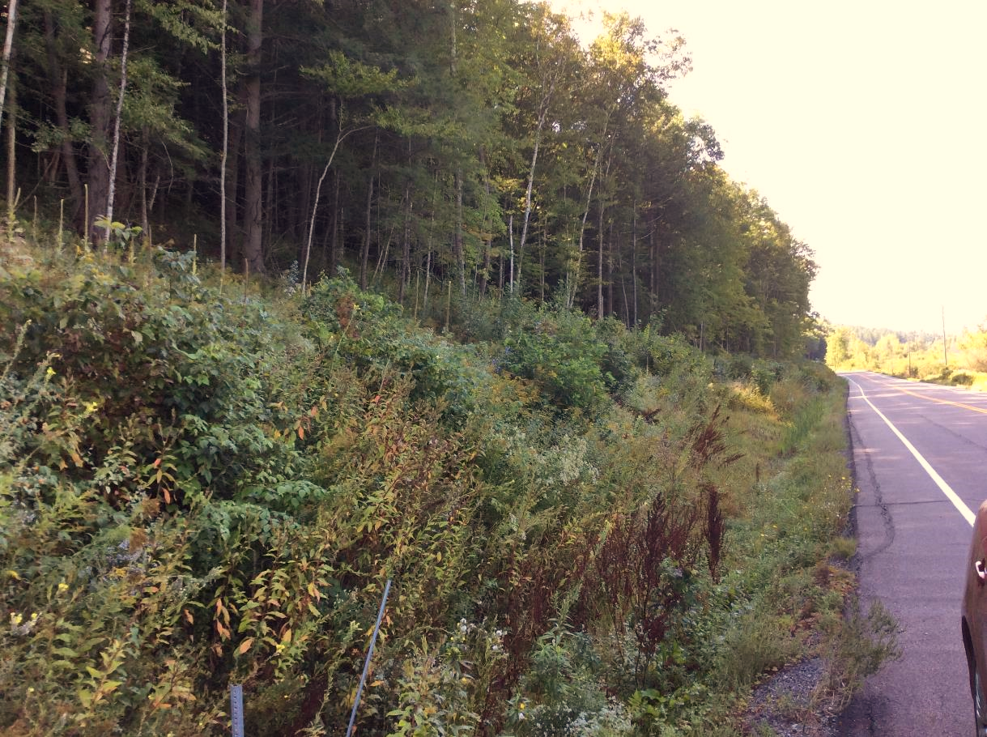
What are our expectations for healthy forests?
Notes:
Roadside forests

Slide 30
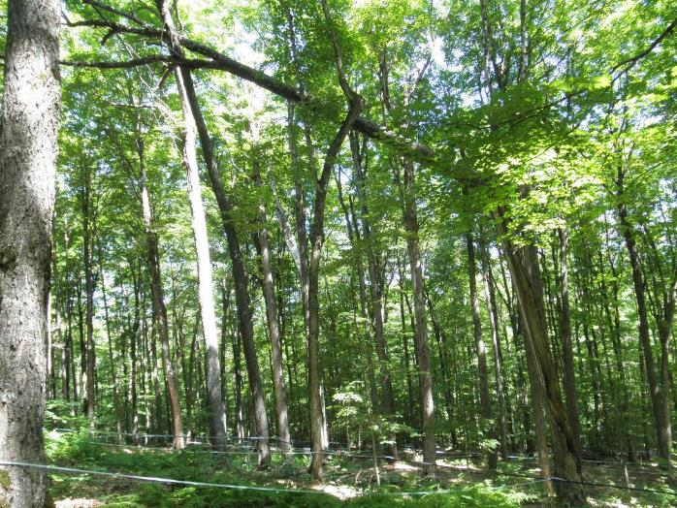
What are our expectations for healthy forests?
Notes:
Forests used for agriculture

Slide 31
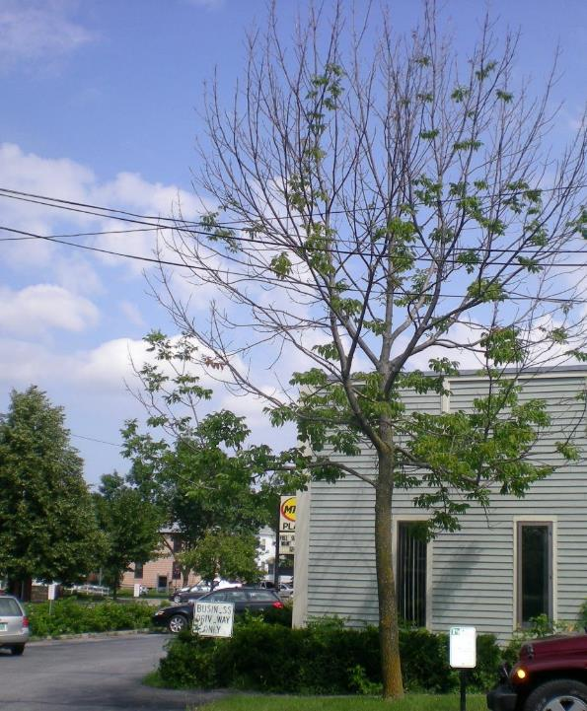
Types and uses of forest influence health determination
Mortality within historical range for municipality
Diversity of species and ages
Canopy cover mitigating summer heat
No new invasive pests
Pollution mitigation greater than …

Slide 32
Thresholds or tipping points for forest health
Management objectives or desired condition
Range of natural variability
Critical loads
Potential concern, uncertain future
Regulatory or policy standards
Notes:
A threshold triggers concern, it may trigger regulatory action, policy action or it may trigger action so that the desired future condition is reached. This assumes that healthy forests is a noun. If healthy forests are a verb, then it would reflect the dynamic nature that we think of as an ecosystem.

Slide 33
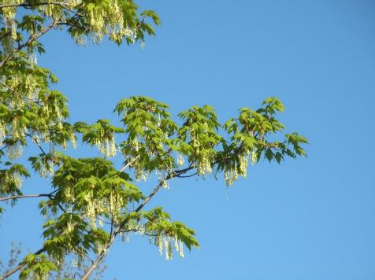
Forest Changes Expected Due To Climate
  Longer growing season
  Shorter winters
  Summer heat and potential drought
  Extreme events
  Carbon dioxide fertilization
  Suitable habitat
  Forest pests and diseases
  Invasive plants
  Wildfire risk
Notes:
This is our challenge. When presented in a simple list, we can think of ways to address each one of these.

Slide 34
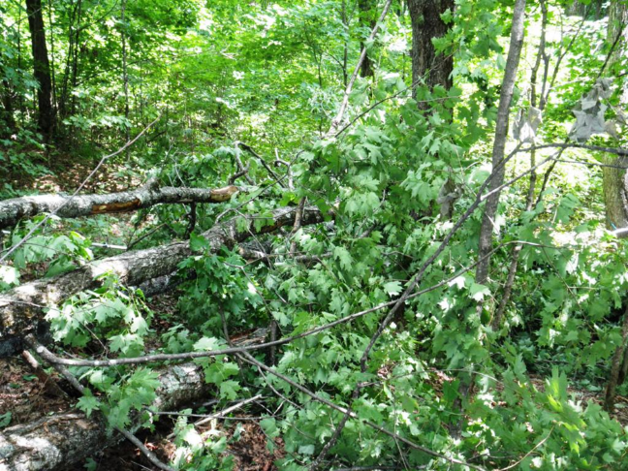
Healthy forests are resilient.
Capable of restoring ecological productivity, complexity and diversity.
Notes:
Many of these disturbances are temporary and trees will recover and forest health will be restored. We have a definition of healthy forests similar to this:

Slide 35
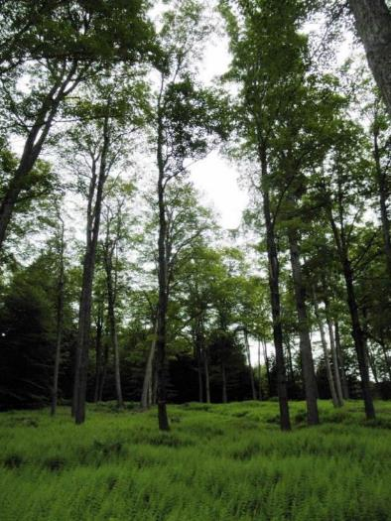
Resilient Forests
Forest ecosystems that when impacted by low intensity disturbance have the ability to quickly recover structure and function to levels similar to pre-disturbance condition
Notes:
Measuring the degree of resilience of a forest is difficult. We really don't know the degree of resilience of a forest until it has been exposed to and changed by stress or disturbance. So we rely on past experience and science that can offer guidance on those factors that will successfully meet the objectives for a landowners. What timeframe? Is health a noun?

Slide 36
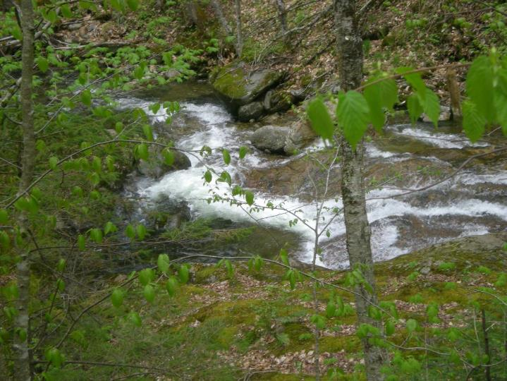

Slide 37
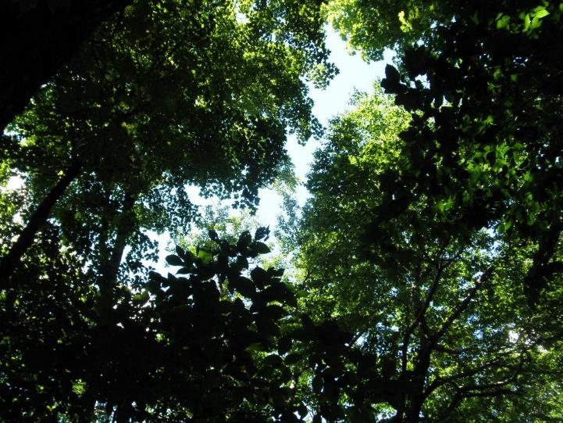

Slide 38
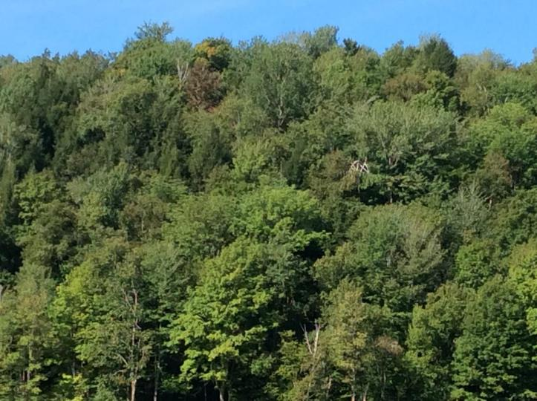

Slide 39
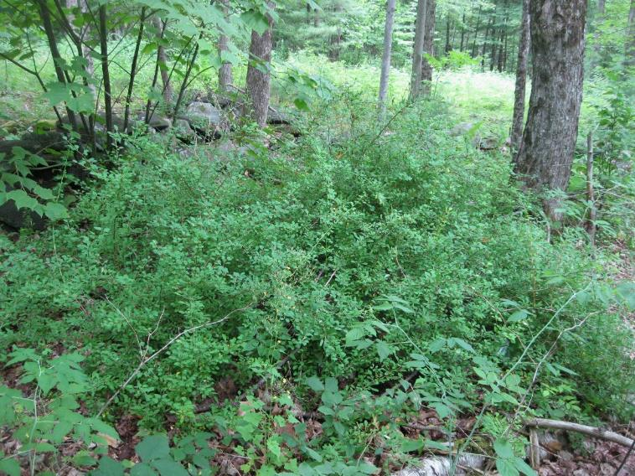

Slide 40
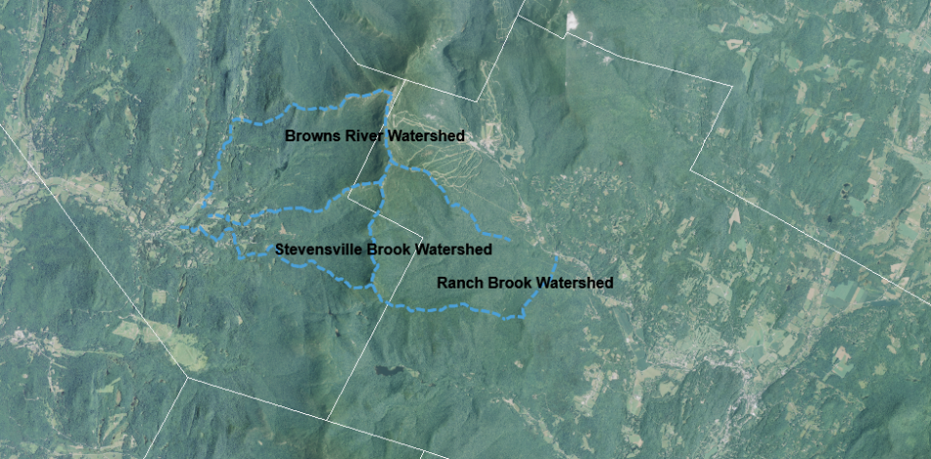
Mount Mansfield
Underhill
Stowe

Slide 41
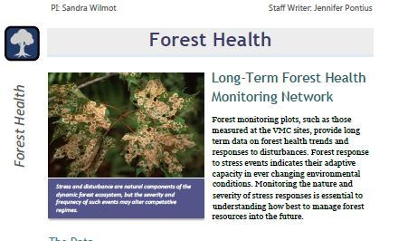
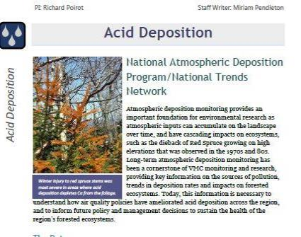







Slide 42

Define what “success” is and work towards it
This will be different/more challenging than in the past so needs to be more intentional.

Slide 43
Future work at landscape level
Protecting forest health will require a mosaic of different stand ages, structures, and levels of management intensity appropriate for satisfying the range of demands placed on the landscape by society

Slide 44


